Slide 1


Designing a Sketch Recognition Front-End: User Perception of Interface Elements
Paul Wais
Aaron Wolin
Christine Alvarado
Harvey Mudd College Department of Computer Science
http://www.cs.hmc.edu
August 2nd, 2007

Slide 2
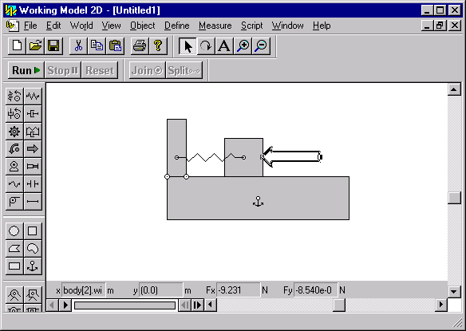
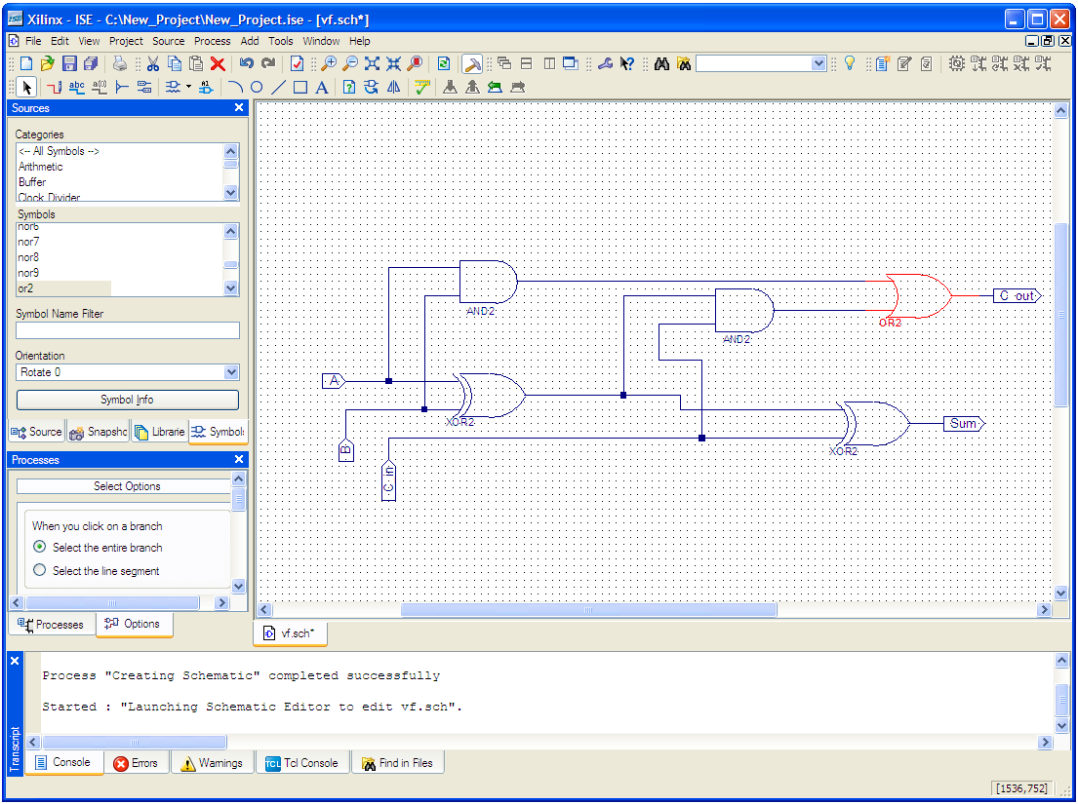
Traditional Simulation Software
Working Model 2D
http://www.workingmodel.com/
Xilinx ISE
http://www.xilinx.com/
"Most of the time the lab was more about battling Xilinx than
actually learning anything useful" –Harvey Mudd Engineering Student
Notes:
A popular sketch-based application: diagram recognition systems that help students run simulations
Mouse and keyboard interfaces can be cumbersome, provide barriers to students’ learning. Examples: Xilinx, Working Model 2D
The user simply wants to turn her design into a simulation. In comparison with sketch recognition systems, these (WIMP-based) interfaces provide a barrier to diagram-centered design.

Slide 3
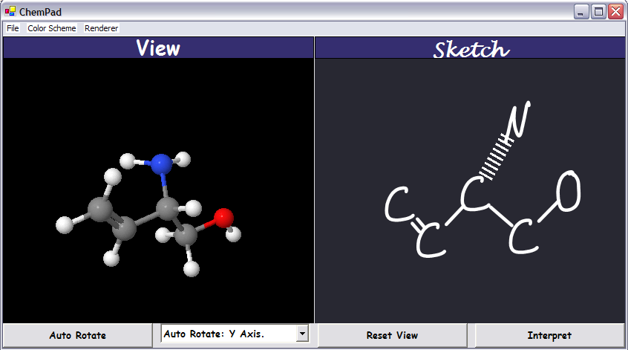
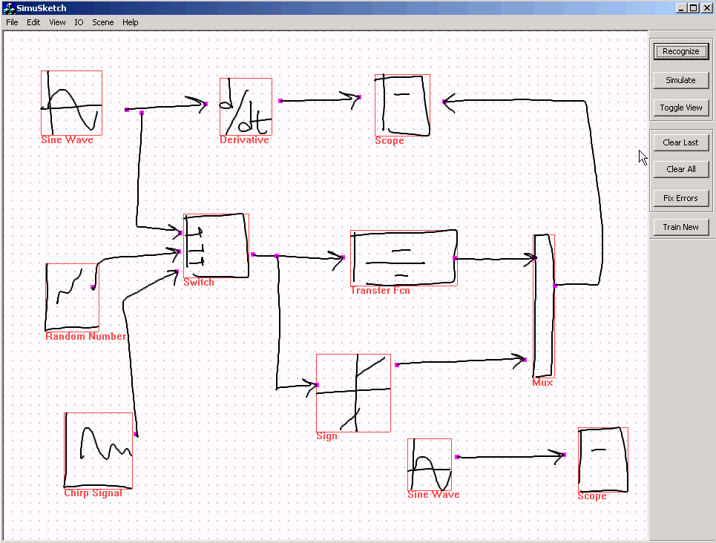
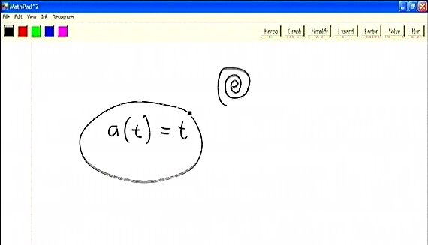
Sketch Recognition Simulation Software
ChemPad
http://graphics.cs.brown.edu/research/chempad/home.html
SimuSketch
http://www.engr.ucr.edu/~stahov/research/simusketch.htm
MathPad²
http://www.cs.brown.edu/~jjl/mathpad/
Notes:
Goals and what we want to investigate
Motivate recognition: talk about how our study does not address gesture- or menu-based recognition and how our users wanted the manually triggered recognition paradigm. Show how others address this paradigm in related work screenshots.
Chempad: gesture-based system (maybe not show it), SimuSkech=recognize button, SimuSketch=text+color feedback, (ACSparc=Color feedback), MathPad=annotation tool + gesture trigger
CHOICES CHOICES CHOICES!!

Slide 4
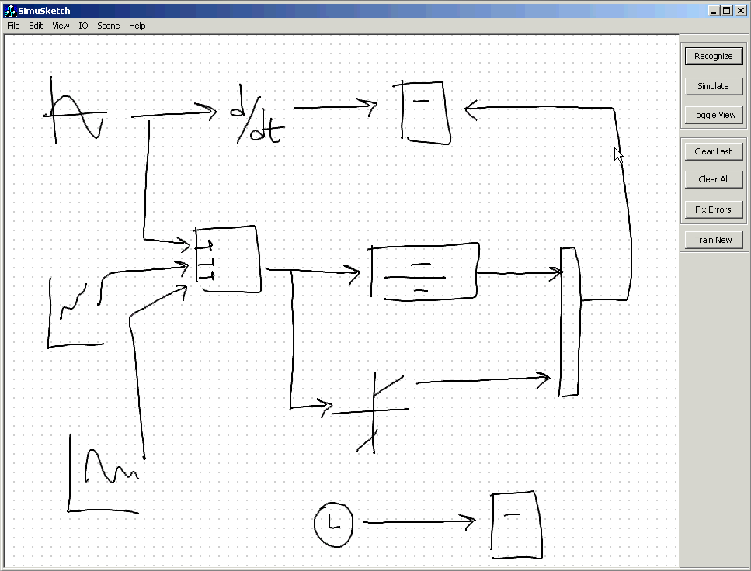
Sketch Recognition Systems
SimuSketch
http://www.engr.ucr.edu/~stahov/research/simusketch.htm
Notes:
Goals and what we want to investigate
Motivate recognition: talk about how our study does not address gesture- or menu-based recognition and how our users wanted the manually triggered recognition paradigm. Show how others address this paradigm in related work screenshots.
Chempad: gesture-based system (maybe not show it), SimuSkech=recognize button, SimuSketch=text+color feedback, (ACSparc=Color feedback), MathPad=annotation tool + gesture trigger
CHOICES CHOICES CHOICES!!

Slide 5
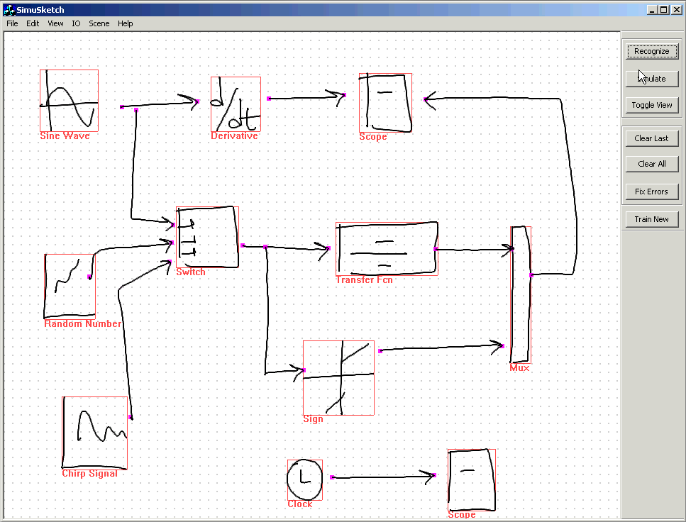
Sketch Recognition Systems
SimuSketch
http://www.engr.ucr.edu/~stahov/research/simusketch.htm
Notes:
Goals and what we want to investigate
Motivate recognition: talk about how our study does not address gesture- or menu-based recognition and how our users wanted the manually triggered recognition paradigm. Show how others address this paradigm in related work screenshots.
Chempad: gesture-based system (maybe not show it), SimuSkech=recognize button, SimuSketch=text+color feedback, (ACSparc=Color feedback), MathPad=annotation tool + gesture trigger
CHOICES CHOICES CHOICES!!

Slide 6
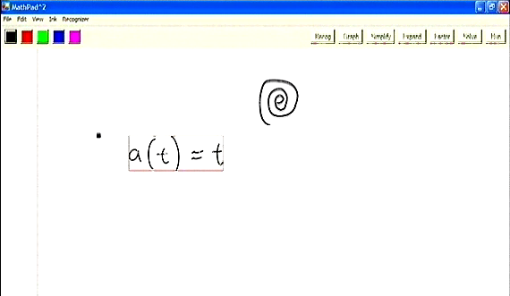
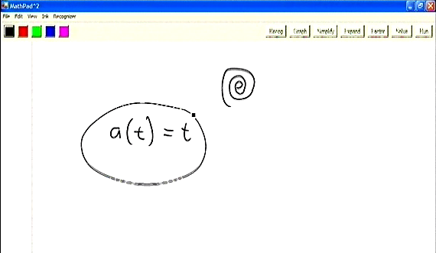

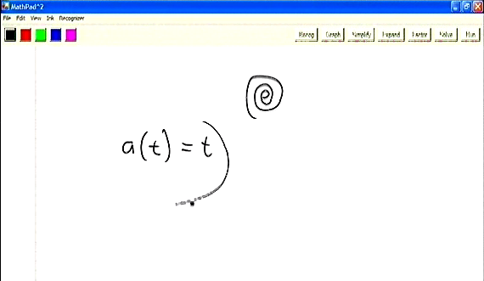
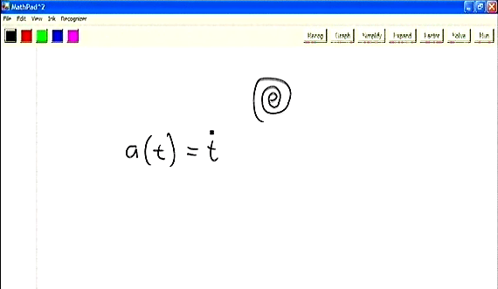
Sketch Recognition Systems
MathPad²
http://www.cs.brown.edu/~jjl/mathpad/
Notes:
Goals and what we want to investigate
Motivate recognition: talk about how our study does not address gesture- or menu-based recognition and how our users wanted the manually triggered recognition paradigm. Show how others address this paradigm in related work screenshots.
Chempad: gesture-based system (maybe not show it), SimuSkech=recognize button, SimuSketch=text+color feedback, (ACSparc=Color feedback), MathPad=annotation tool + gesture trigger
CHOICES CHOICES CHOICES!!

Slide 7
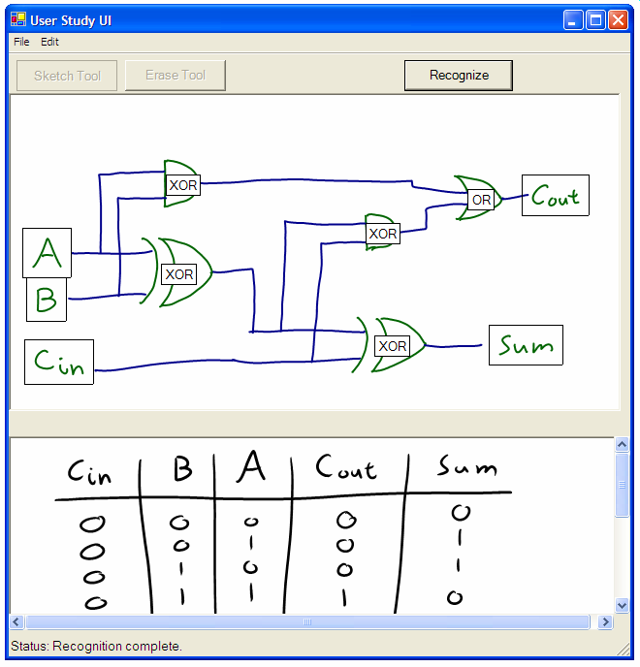
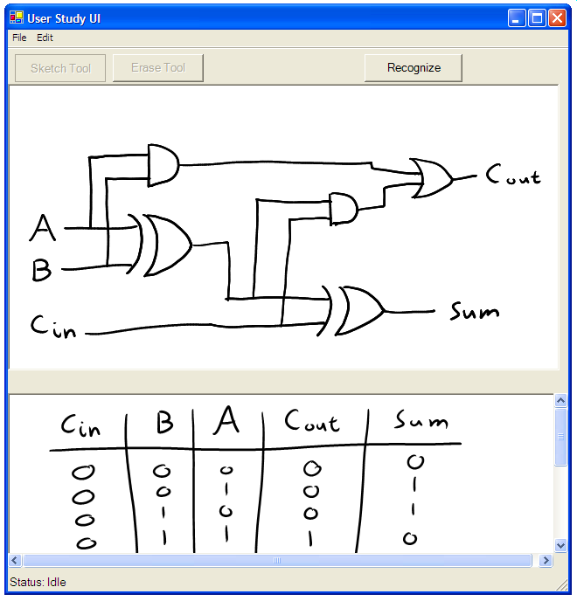
Sketch Recognition User Interface Issues
Recognition Triggers:
How should the user trigger recognition?
Separation Tools:
How should users separate recognized from unrecognized strokes, if at all?
Feedback Mechanisms:
How should the recognition result be displayed?
Error Types:
How do recognition errors impact the user experience?
Notes:
Mention digital design when entering into this slide; explain screenshot
We aim to directly compare several user interface choices that current sketch recognition systems employ. Building a recognizer engine is a challenge within itself; designing and evaluating an interface is an equal, and less well-understood challenge. Today, I will present a user study that investigates issues in sketch recognition interfaces in isolation from a working sketch recognition layer. Our contribution is to directly compare things people have tried. I will present preliminary results that suggest how user preferences may answer these questions.
User interface design of sketch recognition systems aims to make sketch recognition accessible and integrate sketch recognition into ordinary tasks
Though WIMP-based UI design is a well-explored problem, sketch recognition UI design is weakly understood.
End Goals of User Interface Design
Make non-traditional interaction with computers feel natural and intuitive
Maximize user satisfaction
Design a system that users accept
Disclaimer here: we are doing a preliminary study to examine user interface elements… initial results…

Slide 8
Experiment Structure
Study 1:
Recognition Triggers and Separation Tools
  3 Recognition Triggers
  2 Separation Tools
Study 2:
Feedback Mechanisms and Error Types
  2 Feedback Mechanisms
  3 Types of Error
Standard user interface used for both studies. Employs simulated recognition and simulated recognition errors.
Notes:
4 things to test = too much for one study
We used same vanilla UI with diff configurations/widgets for each study. Tell simulated recog and simulated error, so we can test issues w/out building actual recog system (test them in isolation).
I will first talk about the design and results of study 1
METHODOLOGY HERE!! Talk bout prev approaches.. What data we aim to collect in these studies
We aim to directly compare several user interface choices that current sketch recognition systems employ. Building a recognizer engine is a challenge within itself; designing and evaluating an interface is an equal, and less well-understood challenge. Today, I will present a user study that investigates issues in sketch recognition interfaces in isolation from a working sketch recognition layer. Our contribution is to directly compare things people have tried.
---------------
User interface design of sketch recognition systems aims to make sketch recognition accessible and integrate sketch recognition into ordinary tasks
Though WIMP-based UI design is a well-explored problem, sketch recognition UI design is weakly understood.
End Goals of User Interface Design
Make non-traditional interaction with computers feel natural and intuitive
Maximize user satisfaction
Design a system that users accept
Disclaimer here: we are doing a preliminary study to examine user interface elements… initial results…

Slide 9
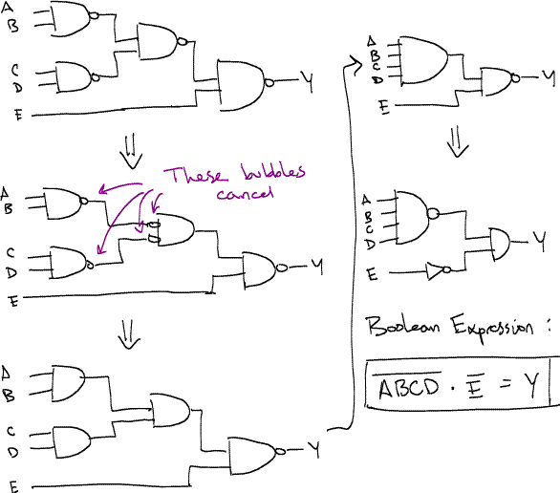
Digital Circuit Design
User Domain: Undergraduate Engineering Students
  past or concurrent enrollment in Harvey Mudd Digital Design course
  some had no Tablet PC experience
  all had previous experience with Xilinx ISE, a mouse-and-keyboard CAD tool
Logic Circuit Design of Harvey Mudd College Engineering Student
Notes:
The context of our study: students did digital circuit design on our vanilla UI
USER POPULATION!!

Slide 10
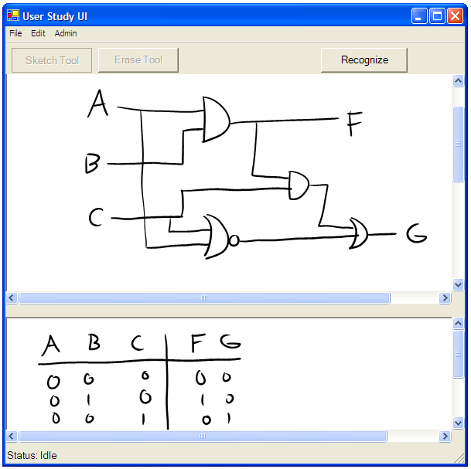
Truth Table Tasks
Both studies asked students to complete truth table tasks:
Task T1
Please draw a circuit diagram for the following truth table:
Inputs |  |  | Outputs
A | B | C | F | G
0 | 0 | 0 | 0 | 0
0 | 0 | 1 | 1 | 0
0 | 1 | 0 | 0 | 1
0 | 1 | 1 | 0 | 0
1 | 0 | 0 | 0 | 0
1 | 0 | 1 | 0 | 0
1 | 1 | 0 | 0 | 1
1 | 1 | 1 | 0 | 0
Truth Table
Completed Circuit Diagram Drawn in UI

Slide 11
User Study 1:
Study Structure
5 Engineering students, 30-45 minute sessions
5 truth table tasks per participant, one task per element
Notes:
Mention that users believed recog was genuine!!

Slide 12
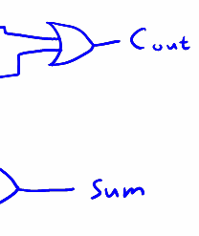
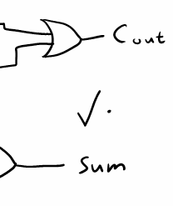
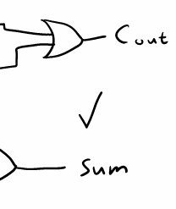
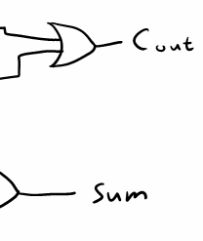
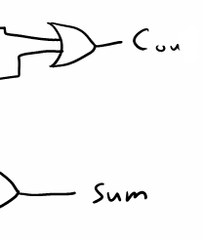
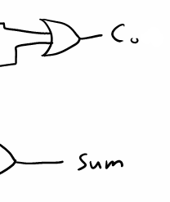
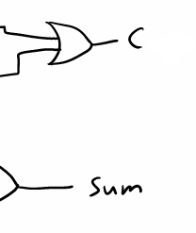
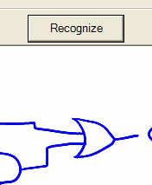
User Study 1: Recognition Triggers
Button
Gesture (Check-Tap)
Pause
Notes:
Goals and what we want to investigate
The elements that support recognition: define them and describe how nobody has compared them before
Based upon pre-study interviews with users and looking at what people have done in the past, we chose these triggers

Slide 13
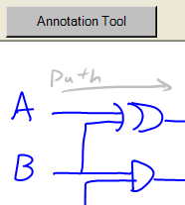
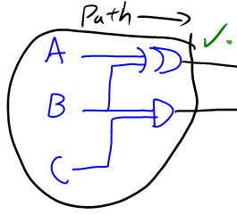
User Study 1: Separation Tools
Color Tool (animation forthcoming)
Lasso Tool (animation forthcoming)
Notes:
Goals and what we want to investigate
The elements that support recognition: define them and describe how nobody has compared them before
When testing these tools, we asked the students to draw an annotation denoting the long (critical) path in the circuit after completing the truth table task

Slide 14
User Study 1:
Simulated Recognition and Error
Simulated Recognition
  System colored strokes when the user triggered recognition
Simulated Error
  System colored a random 10% of strokes “erroneous” (red) and 90% of strokes “correct” (blue)
ANIMATION OF SIMULATED RECOG. TODO
Notes:
Mention that users believed recog was genuine!!

Slide 15
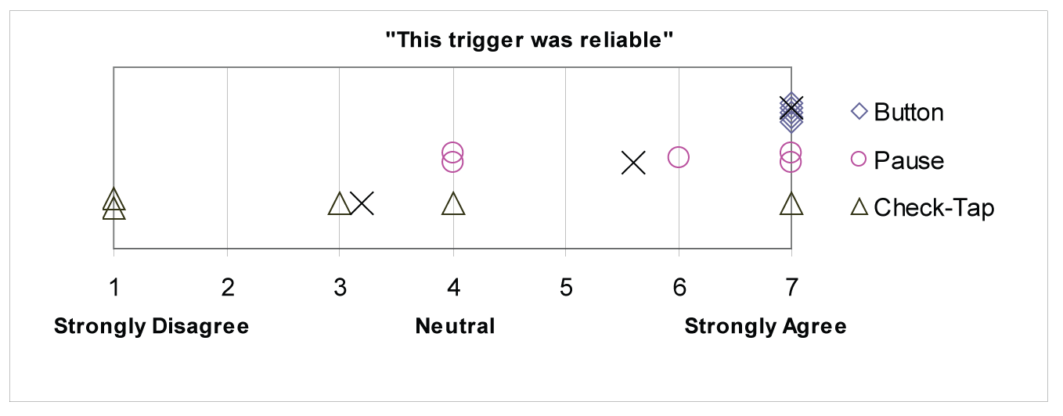
Results: Recognition Triggers
How should the user trigger recognition?
Recognition should be manually triggered
A recognition trigger must be reliable and efficient
Pause trigger was distracting and in need of personalization
Gesture Trigger proved unreliable
  Five failures for every success
Button trigger was reliable and efficient
  3 of 5 users rated button trigger higher than gesture trigger
Survey responses to “This trigger was reliable.”
Individual user ratings
X Mean response
Notes:
The button trigger helped a student make her “approach more systematic.” Another student found “Because [the Gesture Trigger] was less reliable, [she] was more than willing to move [the stylus] to [a] slightly less convenient place on [the] tablet.”
Users can “always get faster with a tool that works every time.”

Slide 16
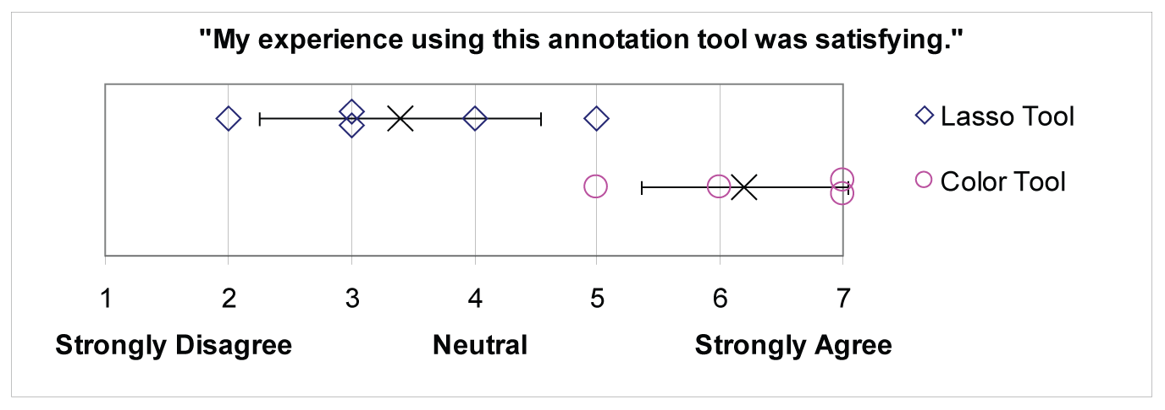
Results: Separation Tools
How should users separate recognized from unrecognized strokes, if at all?
Users prefer a pre-separation tool
Separation should require minimal effort
6 users unanimously preferred Color Tool (pre-separation) to Lasso Tool (post-separation)
Survey responses.
Individual user ratings
X Mean response,
with error bars
for one standard
deviation
Notes:
One user describes that the Color Tool “required less planning about where and when to write so as not to screw up [the] lasso[] [gesture].”
One user comments that the Color Tool “saves [the] inefficient circling motion” of the lasso tool.

Slide 17
Experiment Structure
Study 1:
Recognition Triggers and Separation Tools
  3 Recognition Triggers
  2 Separation Tools
Study 2:
Feedback Mechanisms and Error Types
  2 Feedback Mechanisms
  3 Types of Error
Standard user interface used for both studies. Employs simulated recognition and simulated recognition errors.
Notes:
4 things to test = too much for one study
We used same vanilla UI with diff configurations/widgets for each study. Tell simulated recog and simulated error, so we can test issues w/out building actual recog system (test them in isolation).
I will first talk about study 1
We aim to directly compare several user interface choices that current sketch recognition systems employ. Building a recognizer engine is a challenge within itself; designing and evaluating an interface is an equal, and less well-understood challenge. Today, I will present a user study that investigates issues in sketch recognition interfaces in isolation from a working sketch recognition layer. Our contribution is to directly compare things people have tried.
User interface design of sketch recognition systems aims to make sketch recognition accessible and integrate sketch recognition into ordinary tasks
Though WIMP-based UI design is a well-explored problem, sketch recognition UI design is weakly understood.
End Goals of User Interface Design
Make non-traditional interaction with computers feel natural and intuitive
Maximize user satisfaction
Design a system that users accept
Disclaimer here: we are doing a preliminary study to examine user interface elements… initial results…

Slide 18
User Study 2:
Study Structure
6 Engineering students, 45-75 minute sessions
5 truth table tasks per participant, one task per element
Human-simulated recognition (Wizard of Oz technique)
Notes:
Mention that users believed recog was genuine!!

Slide 19
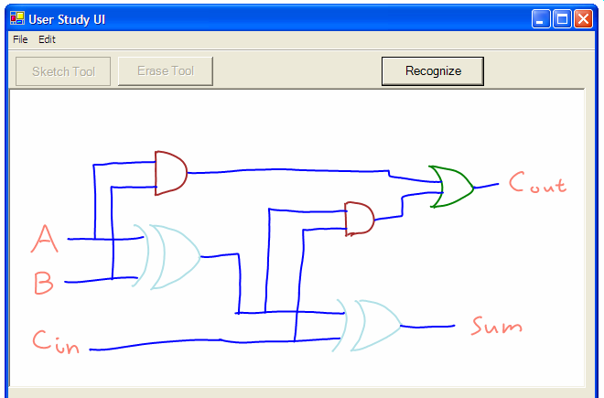
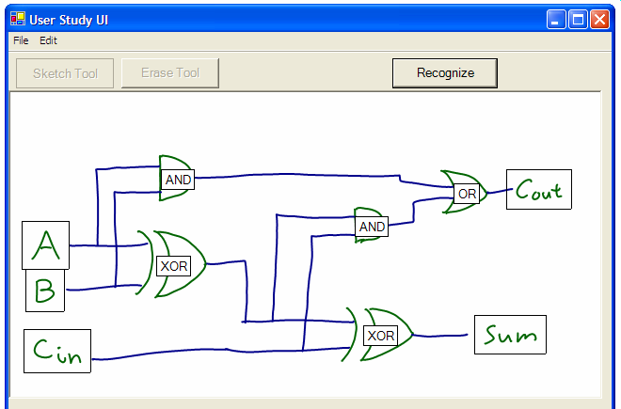
User Study 2:
Feedback Mechanisms
Color Feedback
Text-label Feedback
Notes:
Goals and what we want to investigate
The elements that support recognition: define them and describe how nobody has compared them before
Color feedback, where each type of symbol is color coded; and text label feedback, where symbols of interest are labeled with their names.

Slide 20
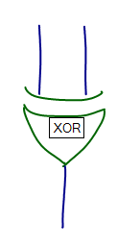

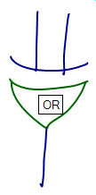
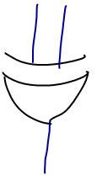
User Study 2:
Error Types
No Error
Mislabel
Grouping Error
Omission
Notes:
Goals and what we want to investigate
The elements that support recognition: define them and describe how nobody has compared them before
Color feedback, where each type of symbol is color coded; and text label feedback, where symbols of interest are labeled with their names.

Slide 21
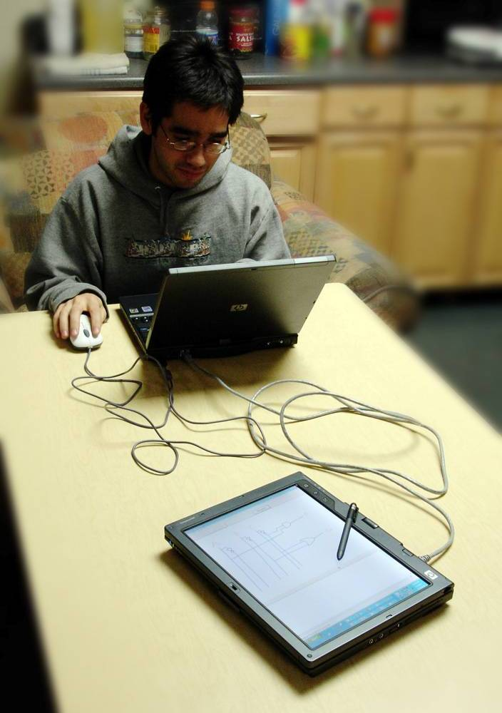
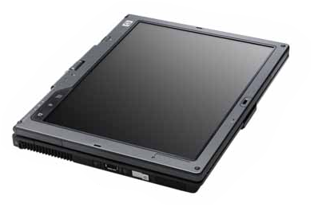
User Study 2:
Wizard-Simulated Recognition and Error
Wizard Machine
Wizard Simulates
Recognition
Network
Connection
Wizard Receives
User Sketch
User Machine
User Draws Circuit
Types of simulated error:
  Wizard-simulated grouping errors
  System-simulated false positives and omissions
  Zero error rate simulated when testing Feedback Mechanisms

Slide 22
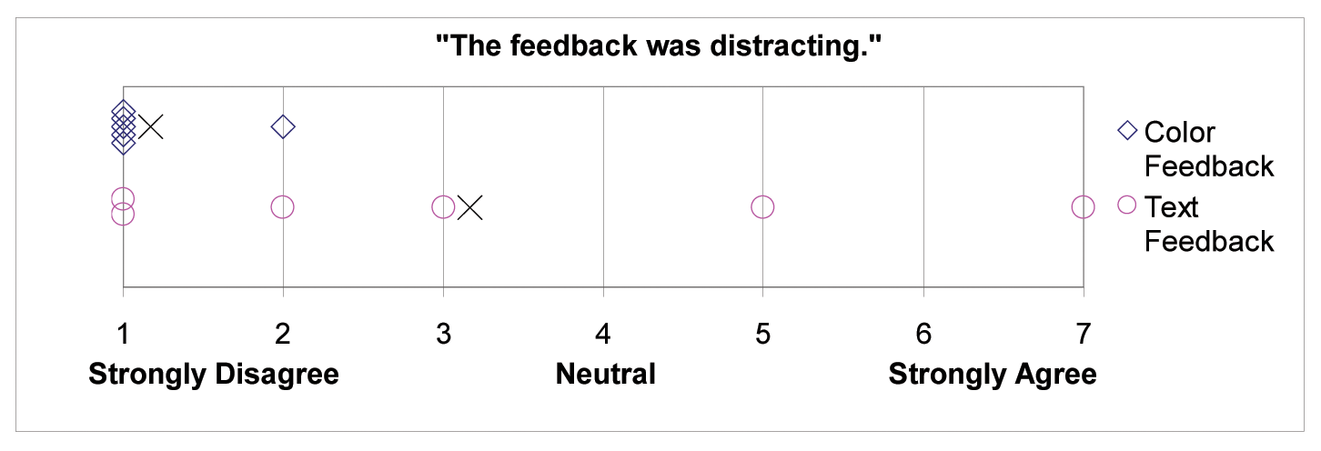
Results: Feedback Mechanisms
How should the recognition result be displayed?
Users prefer minimal transformation of their sketch
Users want minimal clutter and distraction
5 out of 6 users preferred Color Feedback
Text Feedback was more distracting and produced clutter
Survey responses
Individual user ratings
X Mean response
Notes:
(Show Truth Table results as well?)
“The text gets very cluttered [and] covers up the [sketch’s] points of interest quickly.”
One user comments color feedback is “more elegant” and “less redundant.”
Users unanimously find color feedback understandable, (7/7), but three of six users found text feedback 6/7 understandable.

Slide 23
Results: Error Types
How do recognition errors impact the user experience?
Users want errors to be predictable and understandable
Users had diverse mental models of errors
  2 of 6 users blamed themselves for grouping errors
  2 blamed themselves for omission and mislabel errors
  2 users cold not attest to having formed a clear mental model
4 found omissions were the easiest to detect
4 found grouping errors the most confusing
Two of six users would reject tool out of frustration with errors.
TODO MORE DATA THAT SUPPORTS ANSWER TO QUESTION
Notes:
DISCLAIMER: errors were not all generated as balanced as we would have wanted
Try to make a table of quotes or a diagram that illustrates how many users voted one way or another on what error type was hardest/etc?
Image of an error to spice up the slide?
Disclaimer about generated errors?
One user wanted to know “what to move away from.” One user would only accept the system if he could “adapt to” it and reason about errors.
(results on omissions?)
Two of six users would reject tool out of frustration with errors.

Slide 24
Results: Work Styles
Write Notes and Equations
8 out of 9 participants trigger recognition after completing her or his diagram
One user did not want to recognize an uncompleted sketch because he “fe[lt] like [he] should give [the program] something that runs.”
Draw Circuit
Trigger Recognition
Correct Errors
Trigger Recognition Again
Notes:
Recognizing at end allows student to keep design process in “one flow of consciousness” and “go through all errors at one time.”

Slide 25
Current & Future Work
Goals for future studies:
  Improve error simulation
  Expand to other user populations
  Examine user perception of symbol replacement feedback
  Explore other domains

Slide 26
Current & Future Work
Results of User Study 3: Feedback Mechanisms for Truth Tables
  8 of 9 additional users only trigger recognition after completing their diagrams
  Of 12 users, 8 prefer color feedback, 3 prefer data table feedback
    (truth table screenshots/animation)

Slide 27
Conclusions
Circuit Simulator User Interface informed by user studies (Show Circuit Simulator UI screenshot pending icon fixup)
Recognition triggers should be user-invoked, efficient, and reliable
Recognition feedback should involve minimal visual transformation and not produce clutter
Users should be able to separate recognized strokes from unrecognized strokes with a pre-separation tool
Users are willing to correct errors, but errors must be predictable and understandable

Slide 28
Acknowledgements
Kris Karr
Professor Susan Martonosi, Professor Debra Mashek
Sketchers Research Group

Slide 29
Questions?

Slide 30
Study Goals
How should the user trigger recognition?
How should the recognition result be displayed?
How should users separate recognized from unrecognized strokes, if at all?
How do recognition errors impact the user experience?
Notes:
Mention digital design when entering into this slide.
We aim to directly compare several user interface choices that current sketch recognition systems employ. Building a recognizer engine is a challenge within itself; designing and evaluating an interface is an equal, and less well-understood challenge. Today, I will present a user study that investigates issues in sketch recognition interfaces in isolation from a working sketch recognition layer. Our contribution is to directly compare things people have tried.
User interface design of sketch recognition systems aims to make sketch recognition accessible and integrate sketch recognition into ordinary tasks
Though WIMP-based UI design is a well-explored problem, sketch recognition UI design is weakly understood.
End Goals of User Interface Design
Make non-traditional interaction with computers feel natural and intuitive
Maximize user satisfaction
Design a system that users accept
Disclaimer here: we are doing a preliminary study to examine user interface elements… initial results…

Slide 31
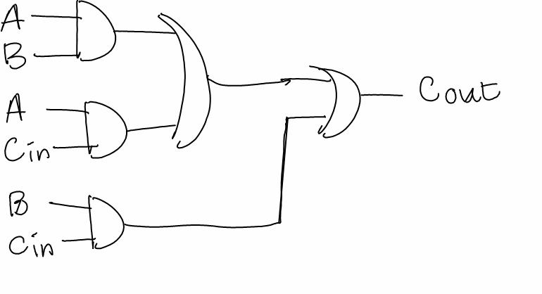
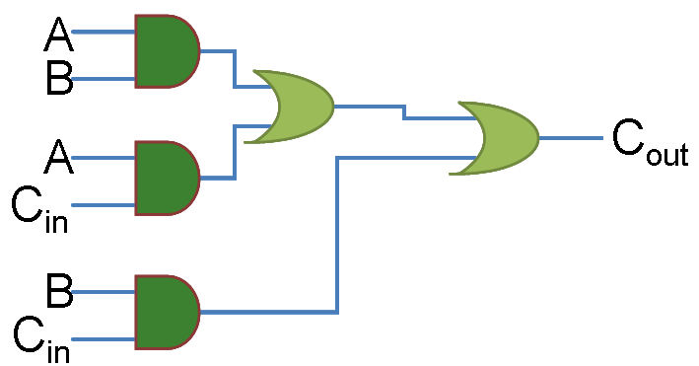
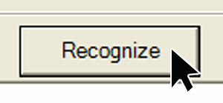
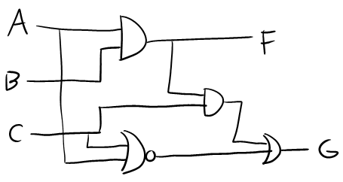
Goals
Goals goals goals
Notes:
User interface design of sketch recognition systems aims to make sketch recognition accessible and integrate sketch recognition into ordinary tasks
Though WIMP-based UI design is a well-explored problem, sketch recognition UI design is weakly understood.
End Goals of User Interface Design
Make non-traditional interaction with computers feel natural and intuitive
Maximize user satisfaction
Design a system that users accept
Disclaimer here: we are doing a preliminary study to examine user interface elements… initial results…

Slide 32
Sketch Recognition User Interface Issues
How should the user trigger recognition?
How should the recognition result be displayed?
How should users separate recognized from unrecognized strokes, if at all?
How do recognition errors impact the user experience?
Notes:
We aim to directly compare several user interface choices that current sketch recognition systems employ. Building a recognizer engine is a challenge within itself; designing and evaluating an interface is an equal, and less well-understood challenge. Today, I will present a user study that investigates issues in sketch recognition interfaces in isolation from a working sketch recognition layer.
User interface design of sketch recognition systems aims to make sketch recognition accessible and integrate sketch recognition into ordinary tasks
Though WIMP-based UI design is a well-explored problem, sketch recognition UI design is weakly understood.
End Goals of User Interface Design
Make non-traditional interaction with computers feel natural and intuitive
Maximize user satisfaction
Design a system that users accept
Disclaimer here: we are doing a preliminary study to examine user interface elements… initial results…

Slide 33
Experiment Design
Study 1: Recognition Triggers and Separation Tools
  5 Engineering students, 30-45 minute sessions
  5 truth table tasks per participant, one task per element
Study 2: Feedback Mechanisms and Error Types
  6 Engineering students, 45-75 minute sessions
  5 truth table tasks per participant, one task per element
Notes:
Quantitative and qualitative data collected

Slide 34

Demo
Notes:
Draw a sketch and hit recognize to get a pre-labeled result; show different feedback mechanisms. Briefly show errors and how to correct them?

